Slide 1
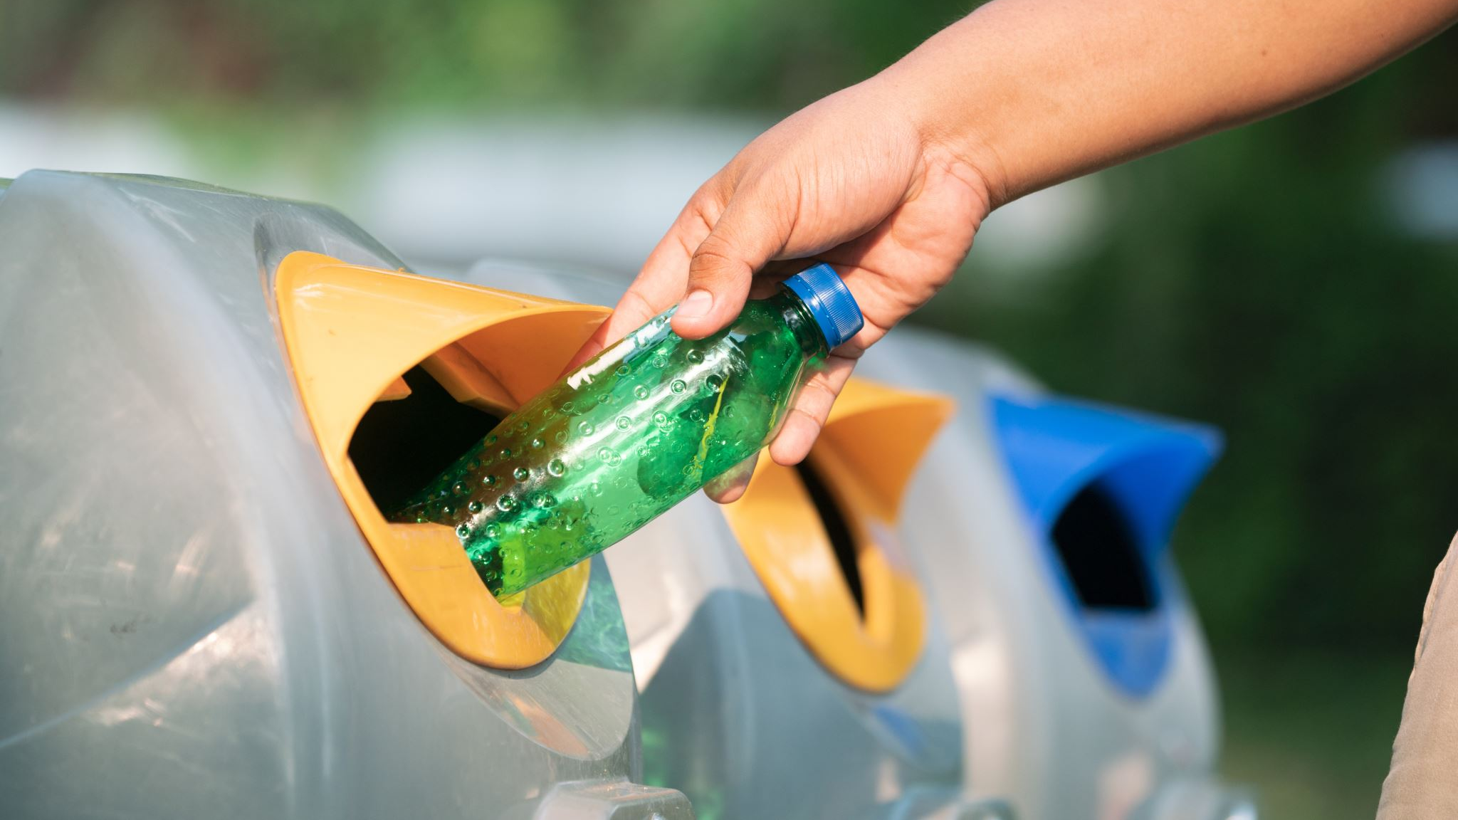
Recycling Revolution: How AI is Transforming Waste Management

Slide 2
Agenda
The Problem with Recycling
The Solution: AI
How AI Can Help
The Benefits of AI Recycling
Challenges and Limitations
The Future of Recycling

Slide 3
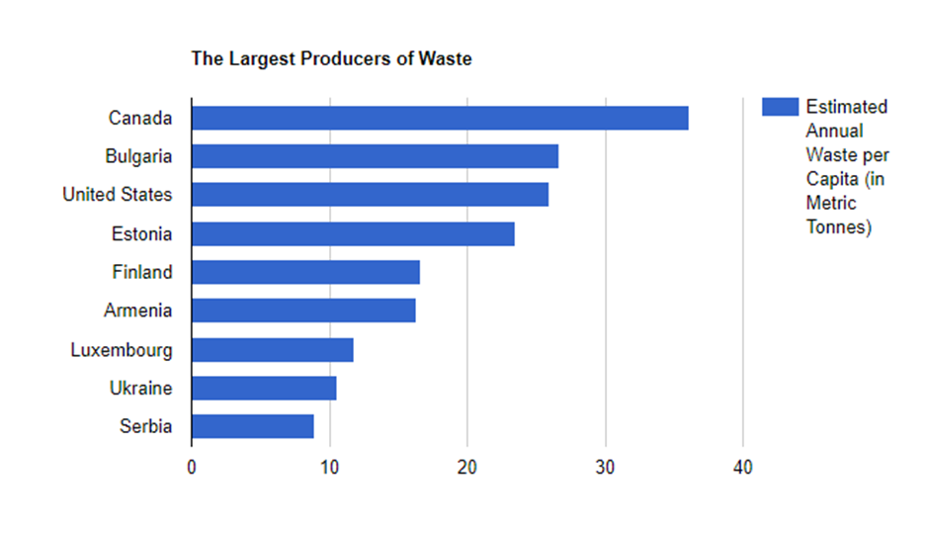
Canada Recycling Rate
Canadians produce 3 million tonnes of plastic waste every year. Only 9% is recycled.
Canada's overall recycling rate stands at approximately 30%

Slide 4
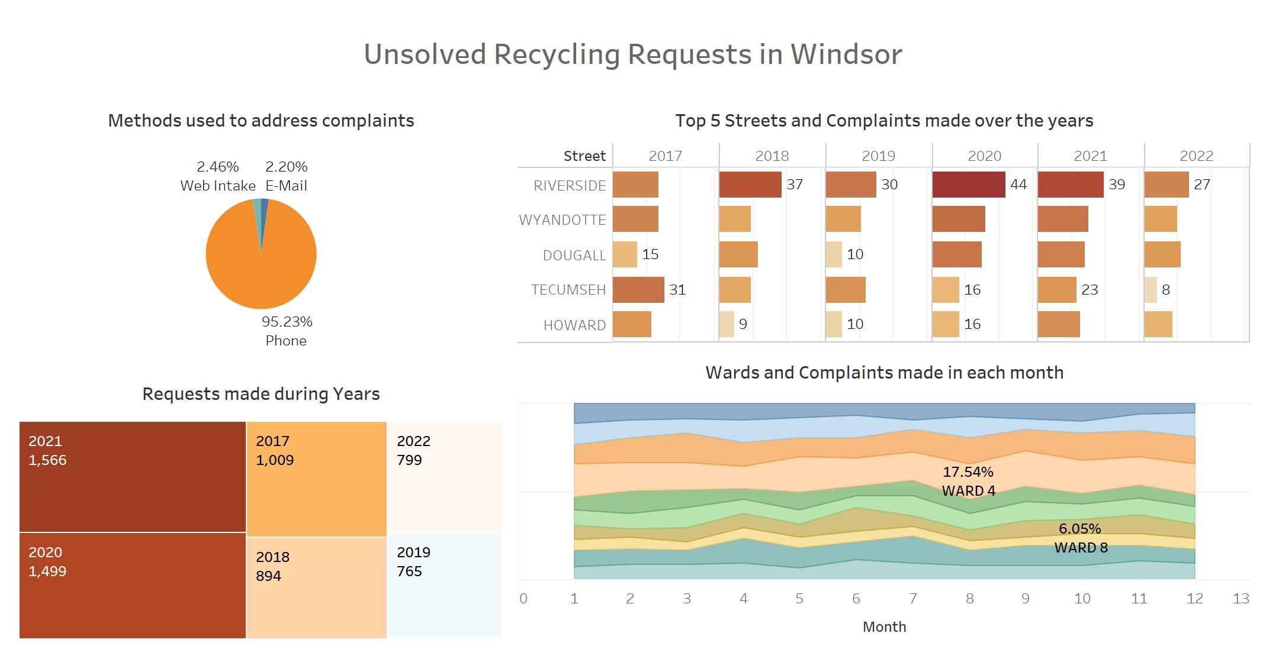

Slide 5
The Problem with Recycling
Recycling is a critical aspect of waste management, but it's not without its challenges. Despite the best efforts of individuals and organizations, recycling rates remain low in many areas, and contamination of recyclables is a persistent problem. The result is that much of what could be recycled ends up in landfills or incinerators, contributing to environmental degradation and climate change.
To address this issue, we need to take a closer look at the recycling process and find ways to make it more efficient and effective. We need innovative solutions that can help us sort and process materials more accurately and quickly, and that's where AI comes in.

Slide 6
The Solution: AI
Artificial intelligence (AI) has the potential to revolutionize the recycling process. By leveraging machine learning algorithms, we can train computers to contribute to improving recycling through automated sorting and contamination detection. This means fewer mistakes and less contamination, which translates into higher recycling rates and less waste.
But it's not just about sorting. AI can also help us optimize the recycling process by identifying inefficiencies and using a smart waste management. With real-time data analysis, we can make smarter decisions about how to handle different materials and reduce our environmental impact even further.
Notes:
AI, or Artificial Intelligence, has the potential to revolutionize the recycling process and address the challenges associated with low recycling rates and contamination.
Automated Sorting: AI-powered robots and machines can be used to automate the sorting process at recycling facilities. By using computer vision and machine learning algorithms, these systems can accurately identify and separate different types of recyclable materials
Contamination Detection: Contamination of recyclables is a significant issue that hinders the recycling process. AI can help identify and remove contaminants by analyzing visual and sensory data

Slide 7

How AI Can Help
AI can help us in many ways when it comes to recycling. For example, machine learning algorithms can be used to identify different types of materials, such as plastic, glass, and metal, with incredible accuracy. This means that we can sort materials more efficiently and effectively, reducing contamination and increasing recycling rates.
AI can also help us identify and remove non-recyclable materials from the recycling stream. By using computer vision technology, we can detect items that don't belong and divert them to the appropriate disposal method. This reduces the amount of waste that ends up in landfills or incinerators, preserving valuable resources and protecting the environment.
Notes:
Furthermore, AI can contribute to optimizing recycling processes by analyzing data and providing insights. By collecting and analyzing data on recycling patterns, waste generation, and consumer behavior, AI algorithms can identify opportunities for improvement. This project AI is used to recommend changes to collection schedules based on waste generation patterns.

Slide 8

Eco-Recycling Revolution Continues:
Welcome to
RecyclingMates
Collectors and Refunds

Slide 9
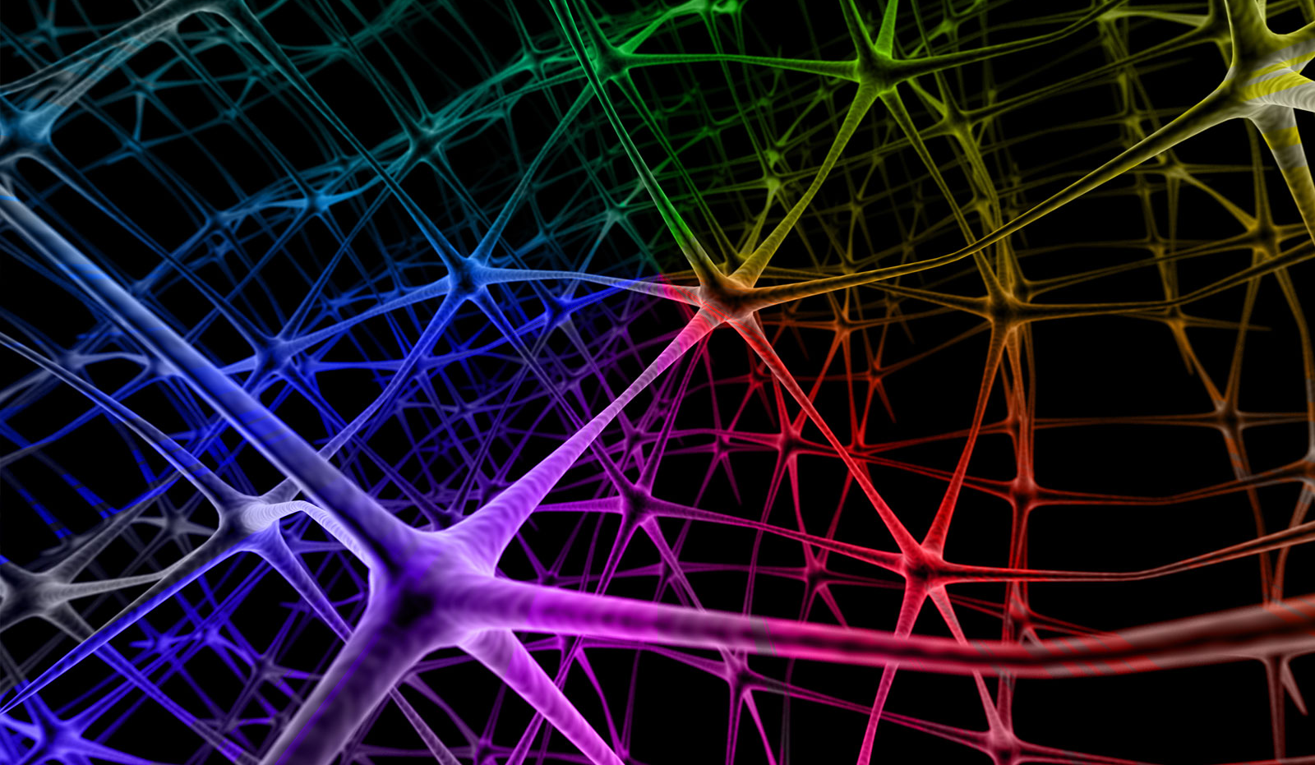
Using Convolutional Neural Networks to Detect and Classify Recyclables
In this project, we are going to use convolutional neural networks (CNNs) to achieve the detection and classification of four specific recyclable materials: plastic bottles, glass bottles, cans, and cardboard. CNNs are a class of deep learning algorithm that can be used for images analysis and pattern recognition tasks, making them suitable for object recognition purposes.
By training our CNN on a large dataset of recyclable items, we can teach the network to identify and distinguish various shapes, colors, and textures associated with each material. This will enable us to sort recyclables more accurately and efficiently, reducing contamination and increasing recycling rates.
Notes:
in this project, we will employ Convolutional Neural Networks (CNNs) to achieve the detection and classification of four specific recyclable materials: plastic bottles, glass bottles, cans, and cardboard. CNNs are a class of deep learning algorithms well-suited for image analysis and pattern recognition tasks, making them highly suitable for object recognition purposes.
By leveraging a comprehensive dataset of recyclable items and training our CNN model on it, we can effectively educate the network to identify and distinguish various shapes, colors, and textures associated with each material. This capability will significantly enhance the accuracy and efficiency of recyclable sorting, ultimately leading to reduced contamination levels and improved recycling rates.

Slide 10
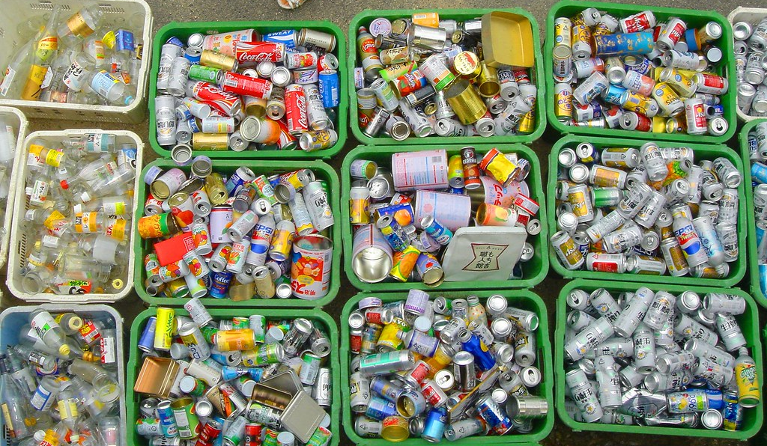
Eco-Recycling Revolution Continues: Collectors and Refunds
Once the objects have been successfully classified and detected through our app, users will receive a notification indicating the potential refund amount they can collect for their recyclables. This incentive encourages individuals to recycle more and helps reduce waste in landfills. Moreover, the application offers the option for users to register as collectors, meaning they are available to pick up recyclable items from different locations within the city.
Our goal is to foster a community of environmentally conscious individuals who collaborate towards waste reduction and promote sustainable living. By using AI technology, we can make recycling easier and more accessible for everyone.
Notes:
By harnessing the power of AI technology, we can simplify and enhance the recycling process, making it more accessible and convenient for everyone involved.

Slide 11

The Benefits Recycling using AI
There are many benefits to using AI for recycling. First and foremost, it increases efficiency and reduces waste. By automating the sorting process, we can process materials faster and with greater accuracy than ever before. This means more materials get recycled and less ends up in landfills or incinerators.
Another benefit is that AI can help us save money. By optimizing the recycling process, we can reduce costs associated with transportation, labor, and equipment. This makes recycling more economically viable, which encourages more businesses and individuals to participate in the process.

Slide 12

Challenges and Limitations
While AI has enormous potential for improving recycling, there are also some challenges and limitations to consider. One of them is accuracy of object recognition can be limited, leading to misclassifications or failure to recognize certain items.
The accuracy of object recognition and recycling estimations depends on image quality and user input. User errors in providing information or subjective factors like object condition can impact recycling estimations.

Slide 13

Results

Slide 14
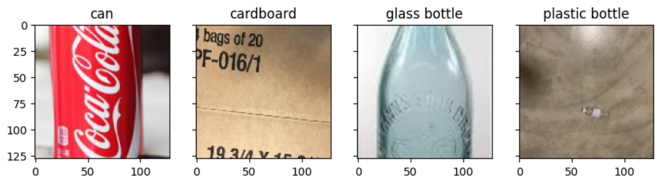
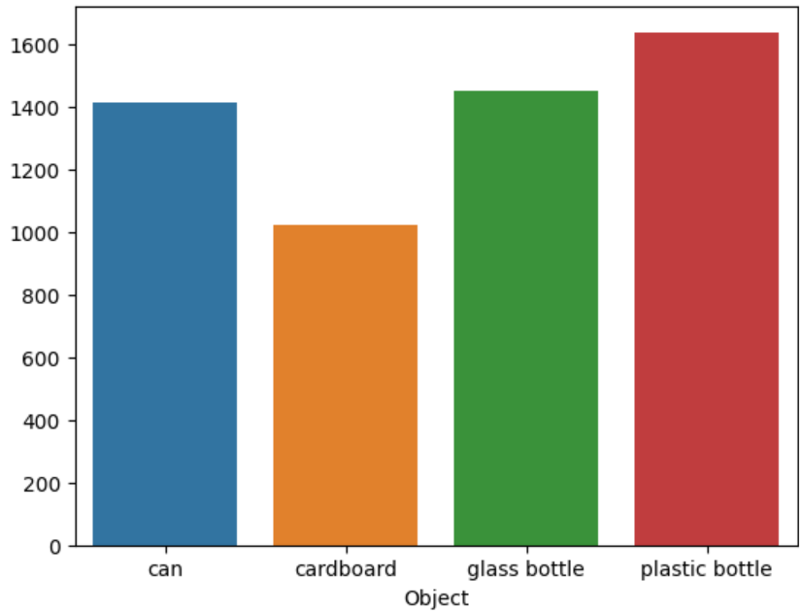

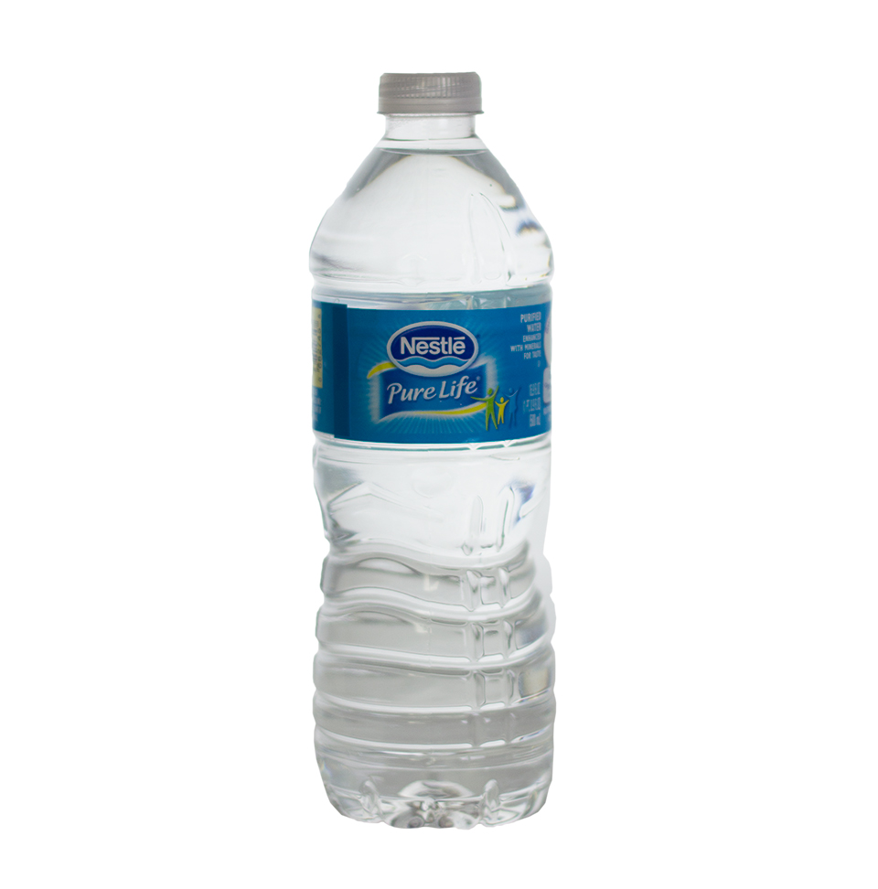
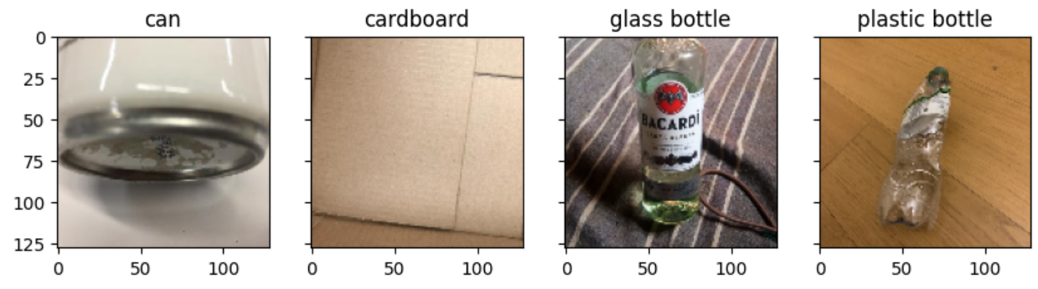

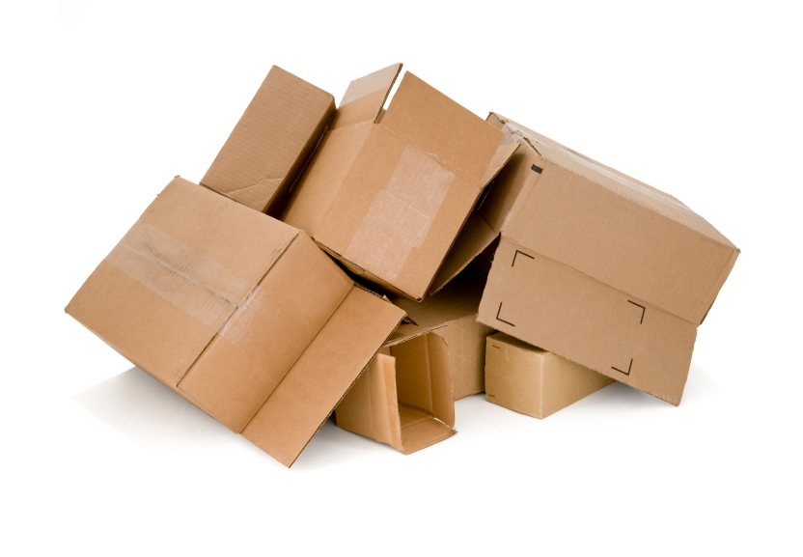
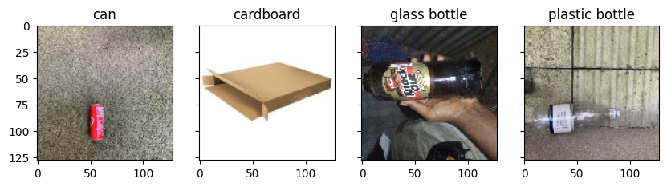
Data exploration:
A total of 5,520 images
1,637
1,414
1,448
1,021
This Photo by Unknown author is licensed under CC BY-SA.
This Photo by Unknown author is licensed under CC BY-SA.
This Photo by Unknown author is licensed under CC BY-NC.
This Photo by Unknown author is licensed under CC BY-SA.
Notes:
Here, we provide information about our dataset, which includes a total of 5,520 images.
The dataset comprises 4 objects for classification: 1.4 thousand images of cans, 1 thousand images of cardboards, 1.4 thousand images of glass bottles, and 1.6 thousand images of plastic bottles.
On the right, we showcase a selection of example images from the dataset.
As you can observe, some of these images pose significant challenges in terms of identification, like the image positioned in the top right corner.

Slide 15
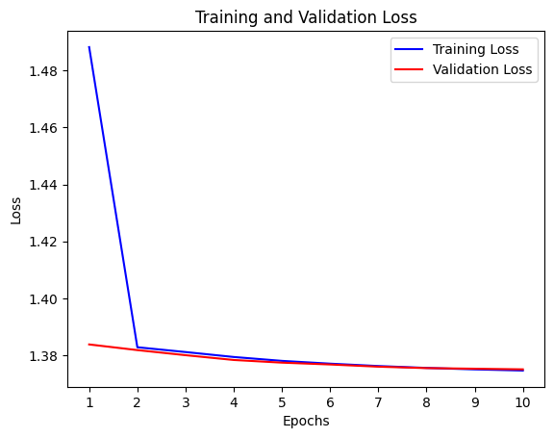
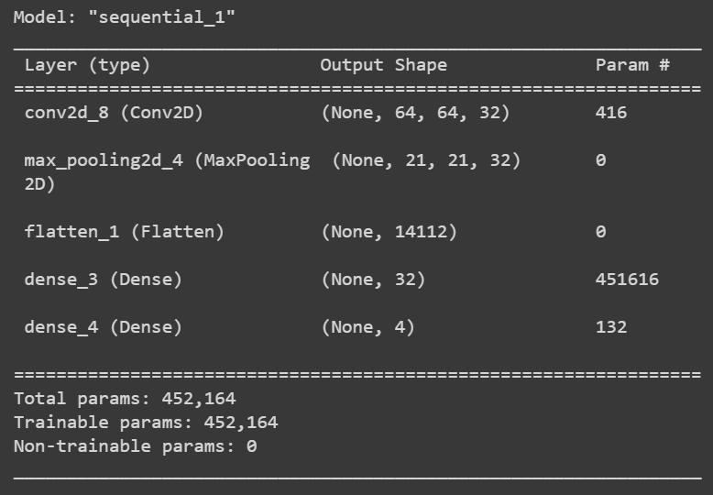
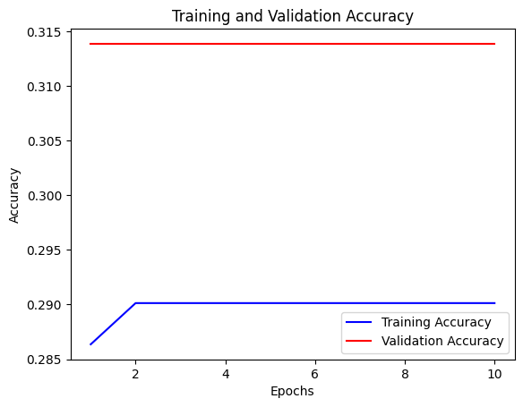
Baseline Model
Total params: 452,164
Training Acc: 0.29
Validation Acc: 0.31
Training time: 22s
Epochs: 10
Notes:
Here, we present our baseline model, consisting of 1 convolutional layer, 1 pooling layer, and 2 dense layers after flattening.
This model has nearly half a million parameters. However, as depicted in the charts on the right, it failed to initiate the training process, and the accuracy remained at 30%.
Consequently, we decided to enhance the power of the CNN architecture.

Slide 16
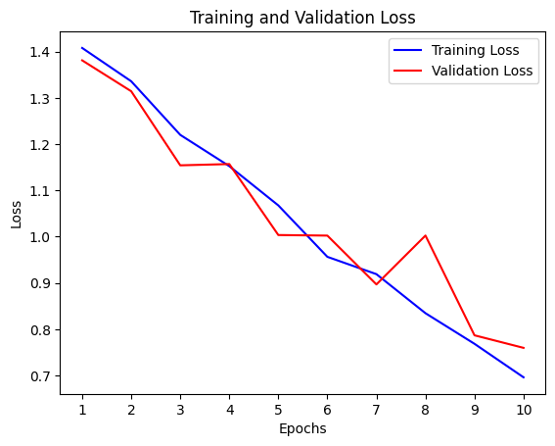
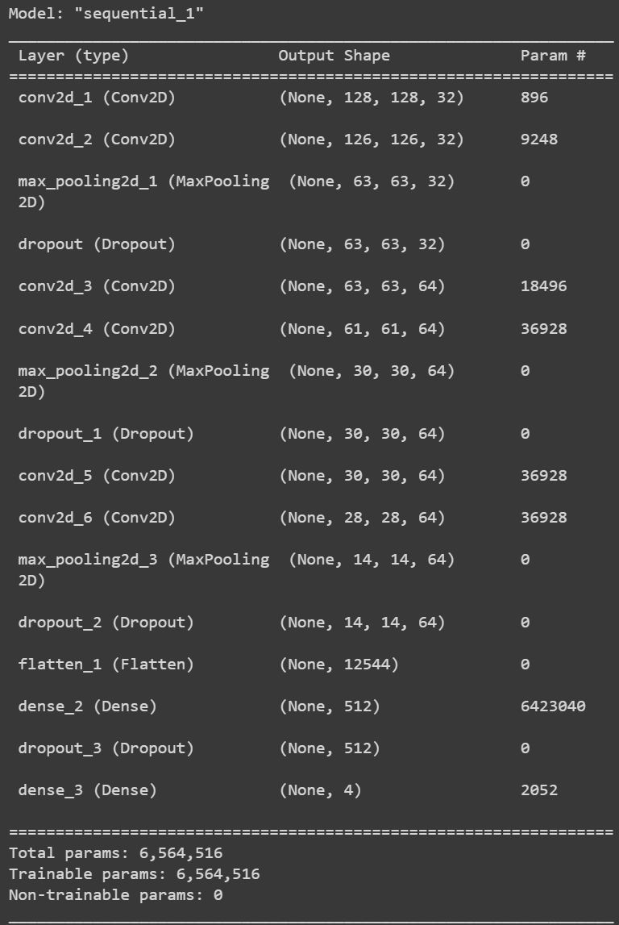
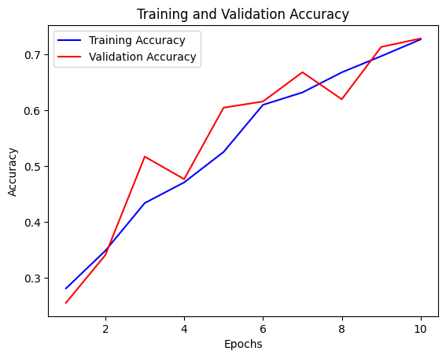
Model 2
Total params: 6. 564.516
Training Acc: 0.73
Validation Acc: 0.73
Training time: 84s (1.4 min)
Epochs: 10
Notes:
In this second model, we introduce a CNN architecture composed of 3 blocks, each consisting of 2 convolutional layers, a pooling layer, and dropouts. Following the flattening process, we incorporate 2 dense layers.
This model is more complex, with approximately 6.5 million parameters.
Through training, we were able to achieve an accuracy of 73% on the validation dataset.
By examining the chart on the right, we could observe that there is room for improvement if we increase the number of epochs.

Slide 17
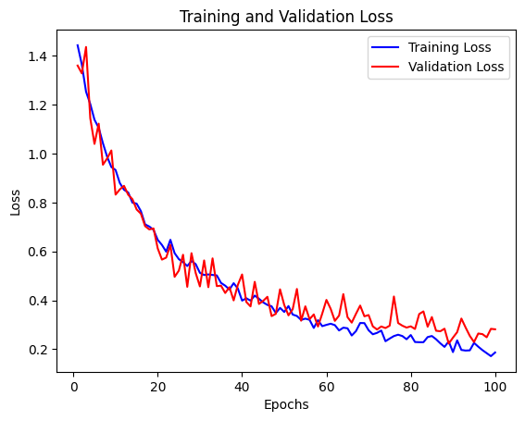
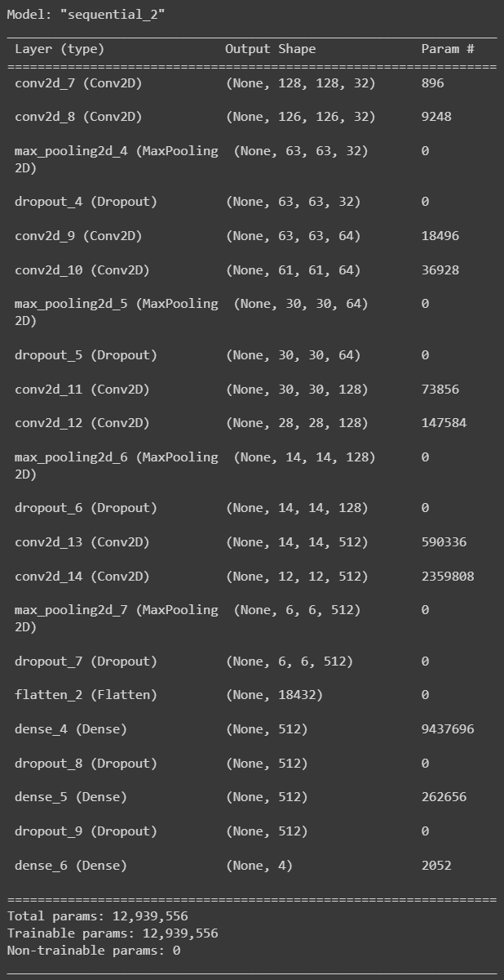
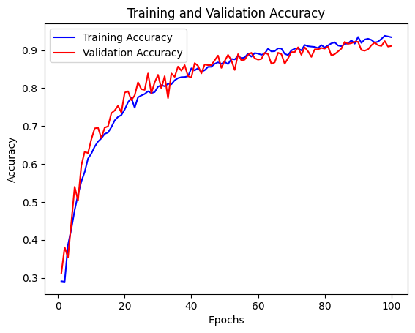
Current best model
Total params: 12,939,556
Training Acc: 0.94
Validation Acc: 0.92
Training time: 3113s (52min)
Epochs: 100
Notes:
This represents our current best model, it has a similar architecture to the previous model.
However, we have expanded it by incorporating 2 additional blocks of convolution and pooling layers, along with an extra dense layer at the end.
Furthermore, we have implemented data augmentation techniques, such as zooming and rotations, to generate more training data.
With over 12 million parameters, this model has achieved an impressive accuracy of 94% on the training dataset and 92% on the validation dataset.
And based on the chart on the right, we strongly believe that there is still room for improvement by increasing the number of epochs.
We anticipate that with further training, we may be able to surpass a 95% accuracy threshold.

Slide 18
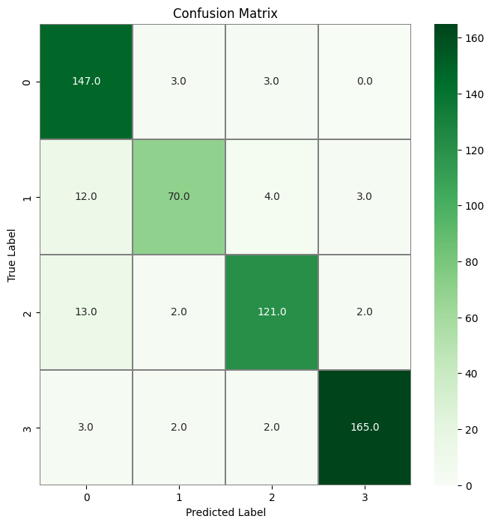
Confusion Matrix
Accuracy
96%
79%
True Label
88%
96%
Predicted Label
Notes:
This chart displays the confusion matrix classification results obtained from our best model.
Here, we can observe the accuracy of the model for each object.
Cans and plastic bottles achieved the highest accuracy, reaching 96%.
Followed by glass bottles, which stand at 88% of accuracy, and cardboard with an accuracy of 79%.

Slide 19

The Future of Recycling
Despite these challenges, we believe that AI has the potential to transform the way we recycle in the future. As technology continues to advance and become more affordable, we expect to see more and more recycling facilities adopting AI solutions to improve their processes.
In the long term, we envision a world where recycling is fully automated and highly efficient, with minimal waste and maximum resource recovery. With AI as our ally, we can work towards a more sustainable future for ourselves and future generations.
Notes:
Indeed, despite the existing challenges, the potential of AI to revolutionize recycling is tremendous. As technology progresses and becomes more accessible, we anticipate a widespread adoption of AI solutions in recycling facilities. This integration will significantly enhance recycling processes and outcomes.
Looking ahead, we envision a future where recycling is completely automated, leveraging AI algorithms to streamline operations and achieve unparalleled efficiency. Through advanced sorting, detection, and classification techniques, AI can minimize waste and maximize resource recovery. This automation will not only increase recycling rates but also contribute to reducing environmental degradation and conserving valuable resources.
By embracing AI as a powerful tool in the recycling industry, we can pave the way for a sustainable future, where waste is minimized, recycling is optimized, and our planet's well-being is prioritized. Together, with continued advancements in AI technology and a collective commitment to environmental stewardship, we can create a world that thrives on sustainable practices for generations to come.

Slide 20
Thanks

